Slide 1
Regional GAW/EMEP station Rucava: modernization plans Aleksandra Kaniščeva Latvian Environment, Geology And Meteorology Centre
TFMM 2021 Online Meeting: 10-12 May 2021

Slide 2
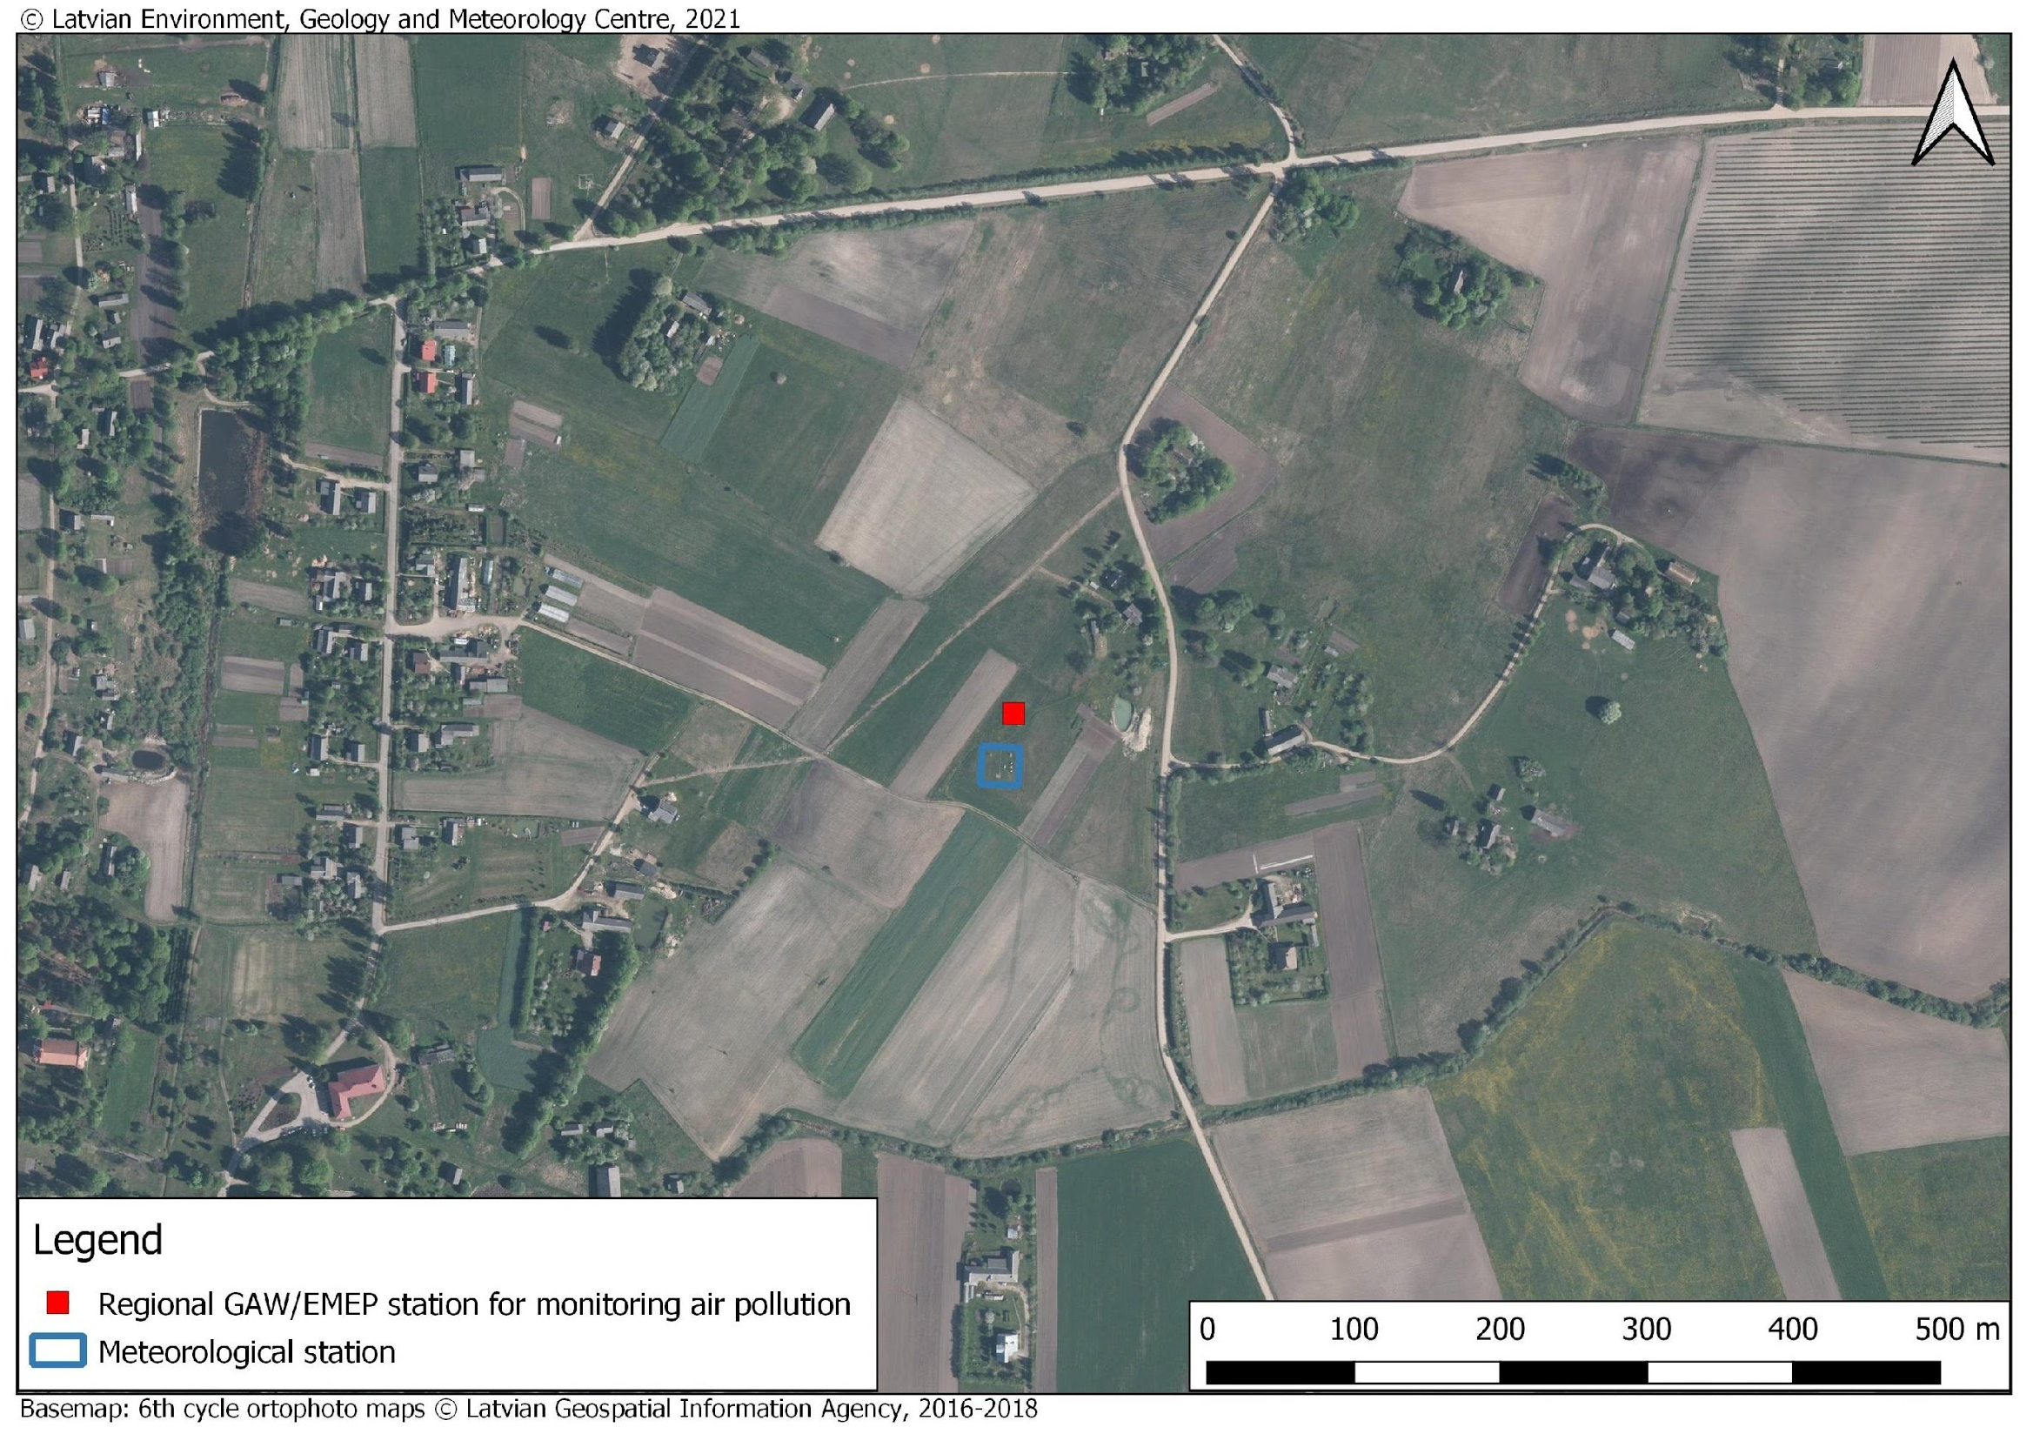
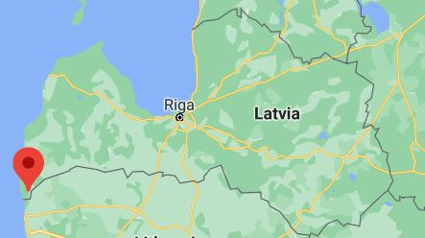
Our station
Established | June 1st 1985
Location | x = 56.162351
 | y = 21.173331
Elevation, m | 18
Annual precipitation, mm | 772
Annual temperature avarage, C° | 6.3
Wind direction | SW, S
Wind speed | 4.2
Snowy days | 72
Sunshine, h/yr | 1874
Vegetation period days | 140-160
Stationary pollution sources(1000m radius) | None
Transport pollution sources(1000m radius) | NOx, CO, PM₁₀, PM_{2.5} and benzene – 5.31 t/year

Slide 3
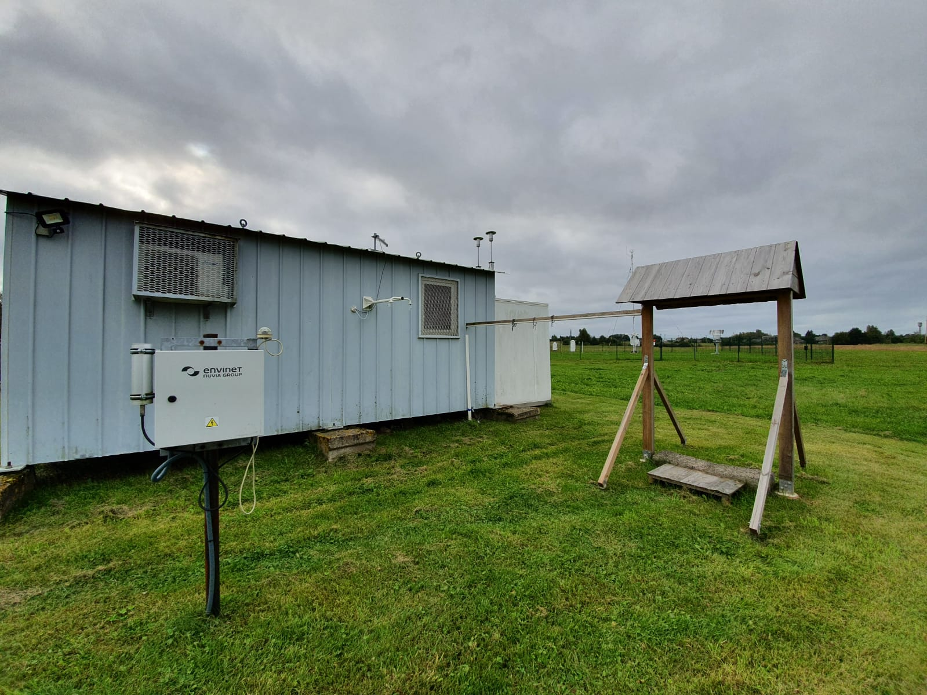
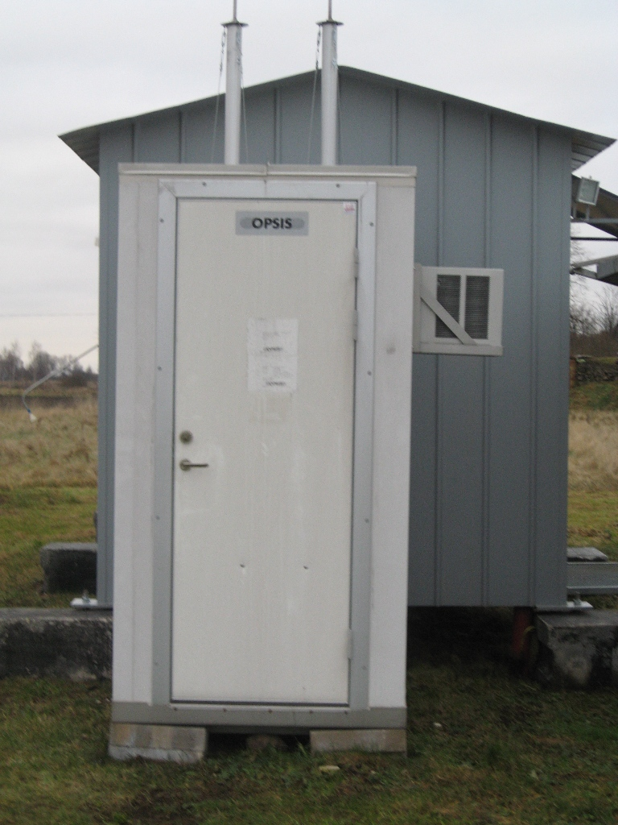
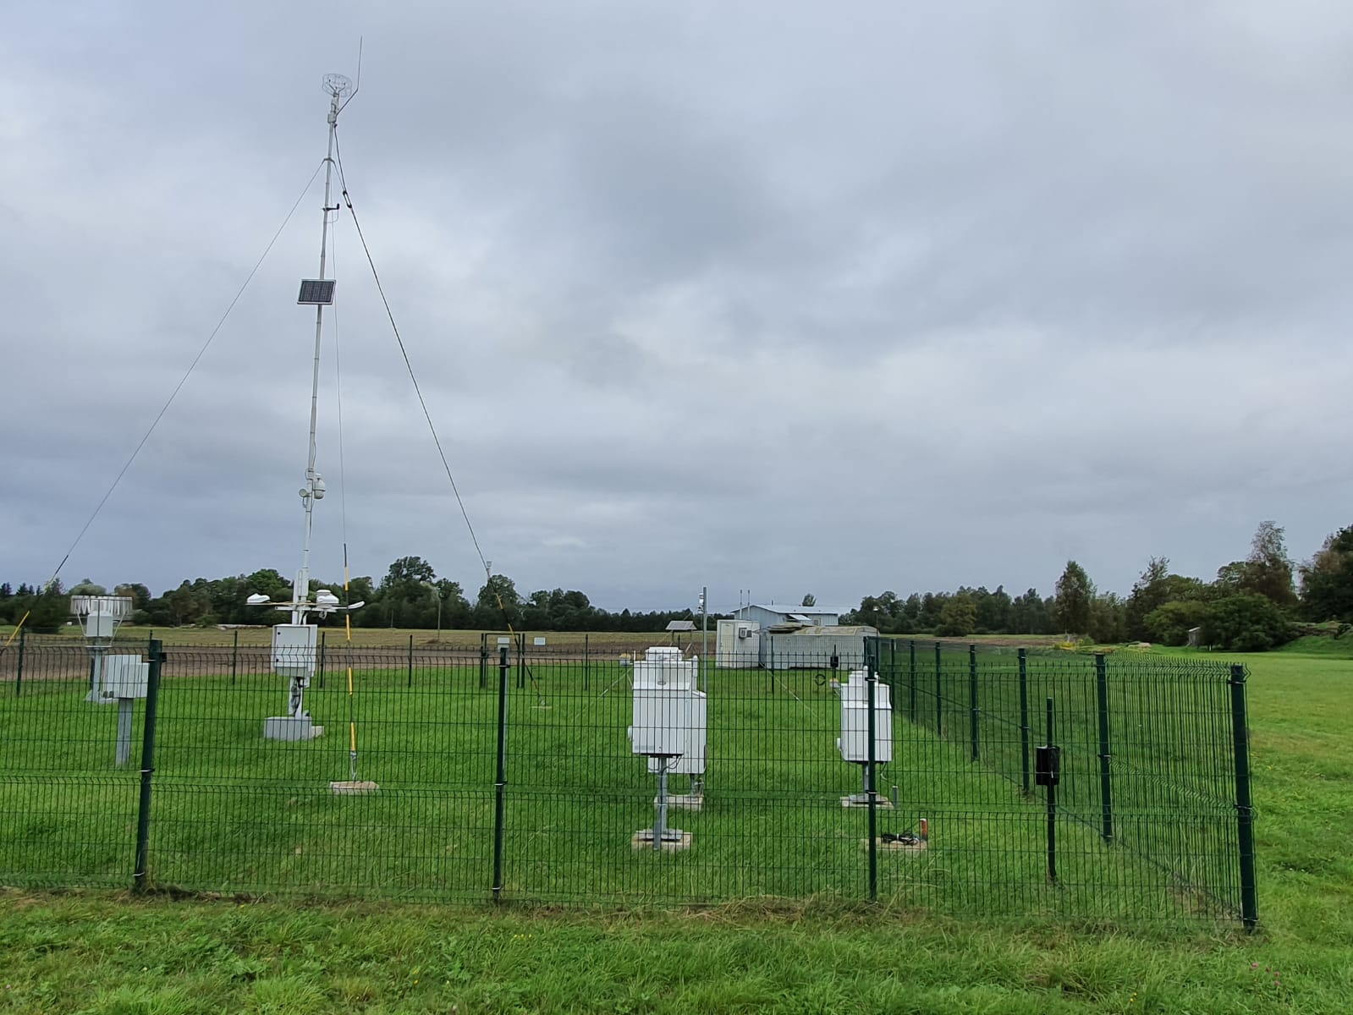
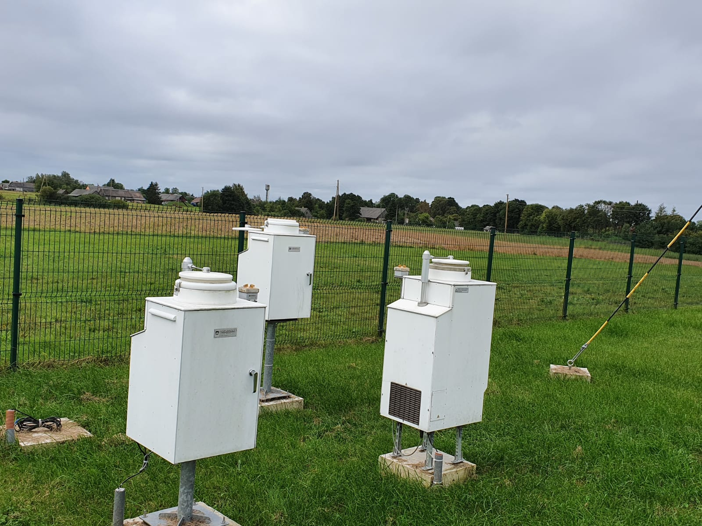
Our station

Slide 4
What we observe
SO₂, NO₂, NO₃ (Nitrate), NH₄ (Ammonium), HNO₃ (Nitric acid), NH₃ (Ammonia), O₃, PM₁₀, PM_{2.5}
PM₁₀ lab analysis: Pb, Cd, As, Ni, other polycyclic aromatic hydrocarbons (benz(a)pyrene, Benzo(a)anthracene, Benzo(b)fluoranthene, Benzo(k)fluoranthene, Dibenzo(a,h)anthracene, Indeno(1,2,3-cd)pyrene ) and benzene
PM_{2.5} lab analysis: base cations and anions (Ca, Na, K, Mg, Cl, SO₄, NO₃, NH₄)
Persistent organic pollutants
Precipitation chemistry: pH, conductivity, SO₄, NO₃, NH₄, Cl, Na, K, Ca, Mg, Cd, Pb, As, Ni, Hg, benz(a)pyrene, Benzo(a)anthracene, Benzo(b)fluoranthene, Benzo(k)fluoranthene, Dibenzo(a,h)anthracene, Indeno(1,2,3-cd)pyrene

Slide 5
How we do it
O₃ – UV absorption method; APOA-360, HORIBA;
SO₂, NO₃ (Nitrate ), NH₄ (Ammonium), HNO₃ (Nitric acid ), NH₃ (Ammonia) – cellulose filter pack system;
NO₂ – porous glass filter in a glass bulb; NILU, Norway;
PM₁₀ and PM_{2.5} – beta radiation absorption method and teflon filters for lab analysis; SM200, Opsis, Sweden;
Benzene – diffusive samplers (Radiello, Italy) with subsequent lab analysis;
Persistent organic pollutants: passive air sampling with PUF disks under MUNI RECETOX(Masaryk University) Monet Europe campaign;
Precipitation chemistry – “WET-Only” samplers, NSA 181/KE; Germany.

Slide 6
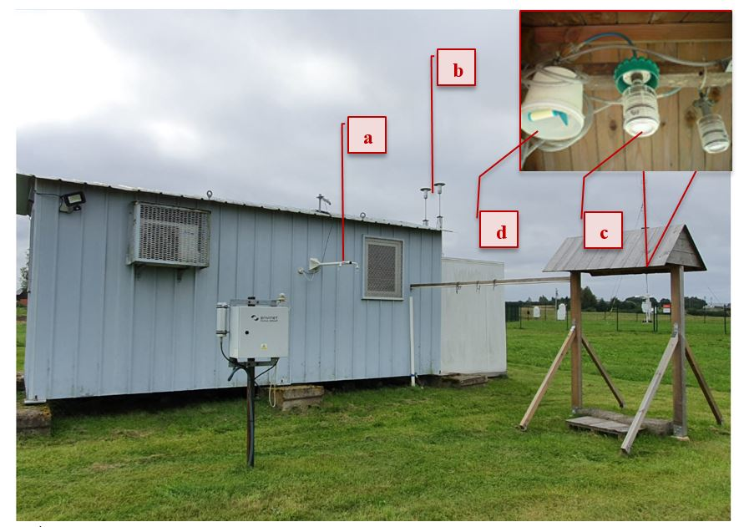
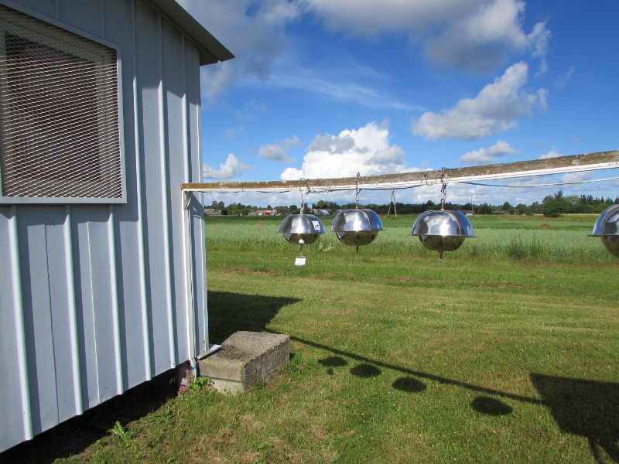
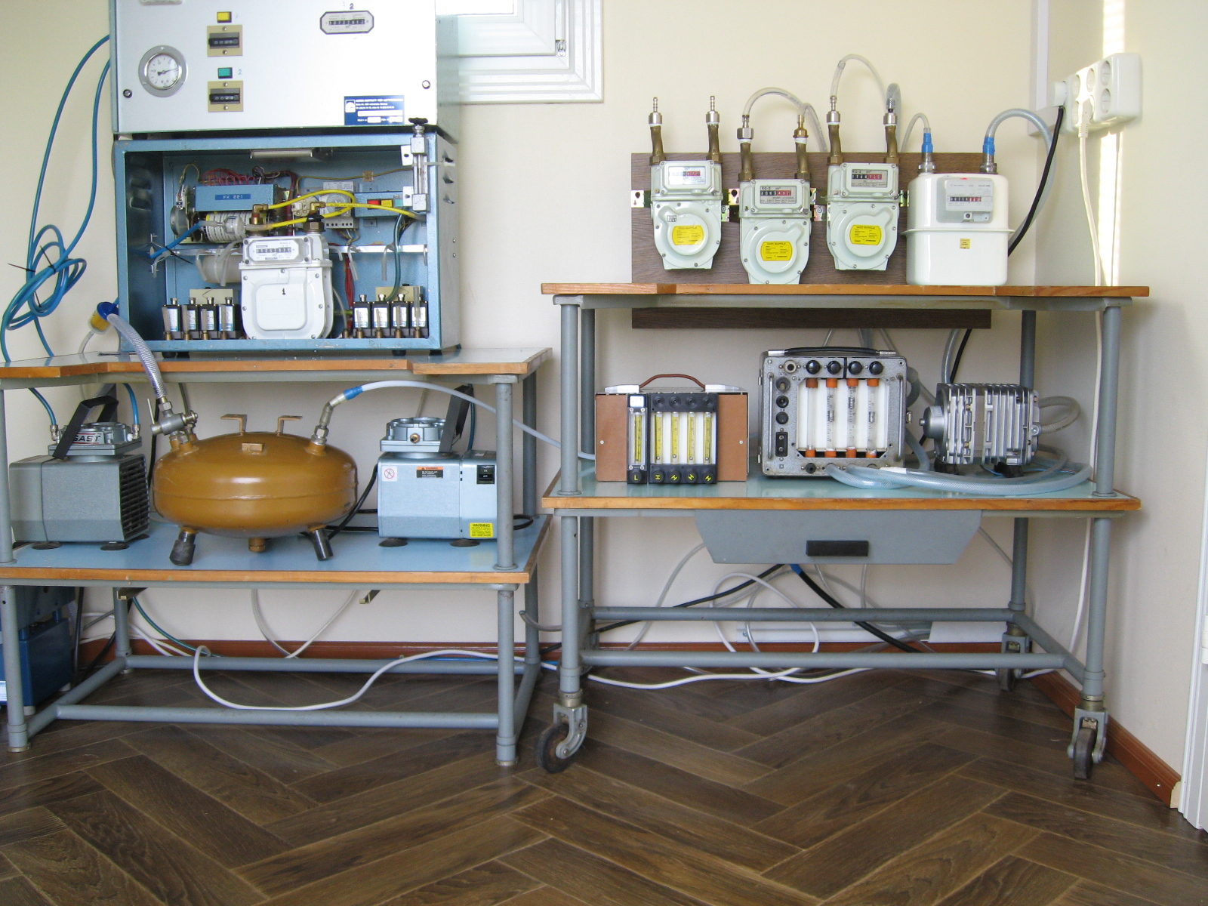
How we do it
e
f
a – O₃
b - PM₁₀ and PM_{2.5} sampling devices
c – filter pack system
d – diffusive samplers
e – POP passive samplers
f – the inside of the station

Slide 7
Modernization plans FOR 2021
01
SO₂
UV fluorescence method, TELEDYNE (USA) T100
02
N-NO₂
Hemiluminescence method, TELEDYNE (USA) T200
03
PM₁₀ and PM_{2.5}
Beta ray absorption method, MET ONE INSTRUMENTS (USA) BAM 1020
04
PM₁₀ and PM_{2.5} lab analysis
140/150 mm membrane filters from high volume sampler, MCZ (Germany) HVS 16
05
140/150 mm membrane filters from high volume sampler, MCZ (Germany) HVS 16
PM_{2.5} lab analysis: organic and black carbon
06
Hg
Atom absorption with Zeeman background correction method, LUMEX (Canada) RA915AM
Funding: EU Cohesion Fund

Slide 8
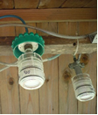
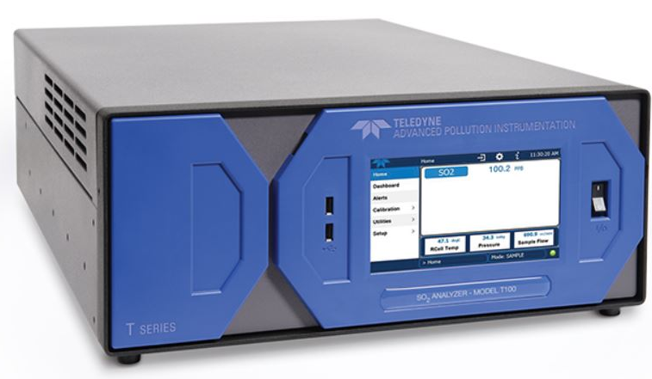
01 - SO₂
Model T100 with NumaView™ Software UV fluorescence SO₂ Analyzer
Exceptional stability
Correction for changes in UV lamp intensity.
Inaccuracies prevention due to interference.
intuitive user interface;
allows for a remote connection with virtual interface and data downloading capability.
Daily
Hourly

Slide 9
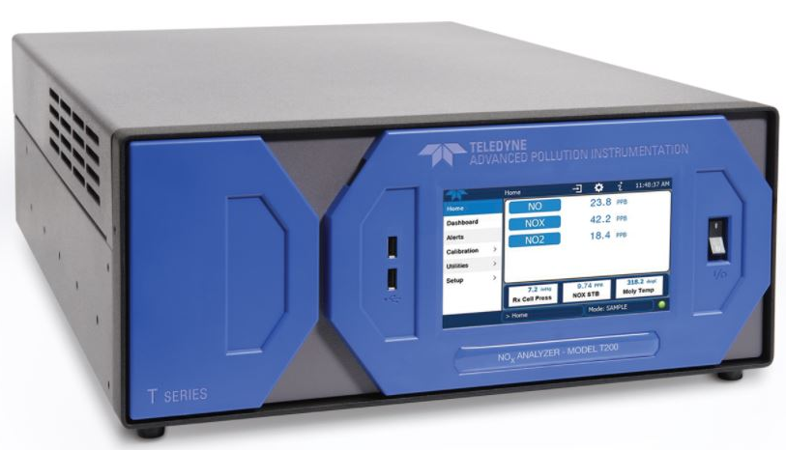
02 - N-NO₂
Model T200 with NumaView™ Software. Chemiluminescence NO/NO₂/NO_{X} Analyzer
zero drift correction, optimized performance under changing conditions;
intuitive user interface;
allows for a remote connection with virtual interface and data downloading capability.
Daily
Hourly

Slide 10
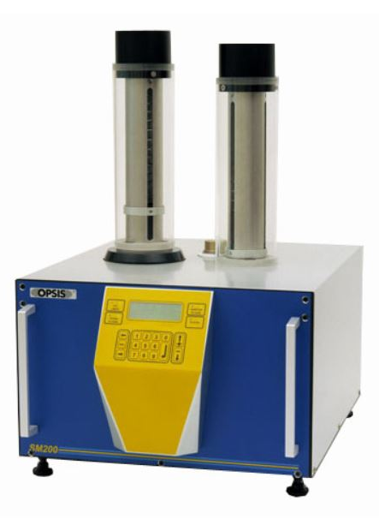
03 - PM₁₀ un PM_{2.5}
Beta ray absorption method, MET ONE INSTRUMENTS (USA) BAM 1020
industry-proven principle of beta ray attenuation
data is available in a variety of formats including daily reports, last record, all data, and new records since last download
Daily
Hourly

Slide 11
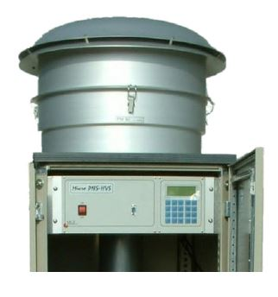
04 & 05 - PM₁₀ un PM_{2.5} lab analysis
140/150 mm membrane filters from high volume sampler, MCZ (Germany) HVS 16
Up to 16 quartz sampling filters
Wide flow range
Constant flow and volume control
Bi-weekly
Daily sampling, analysis 1-3 times a week

Slide 12
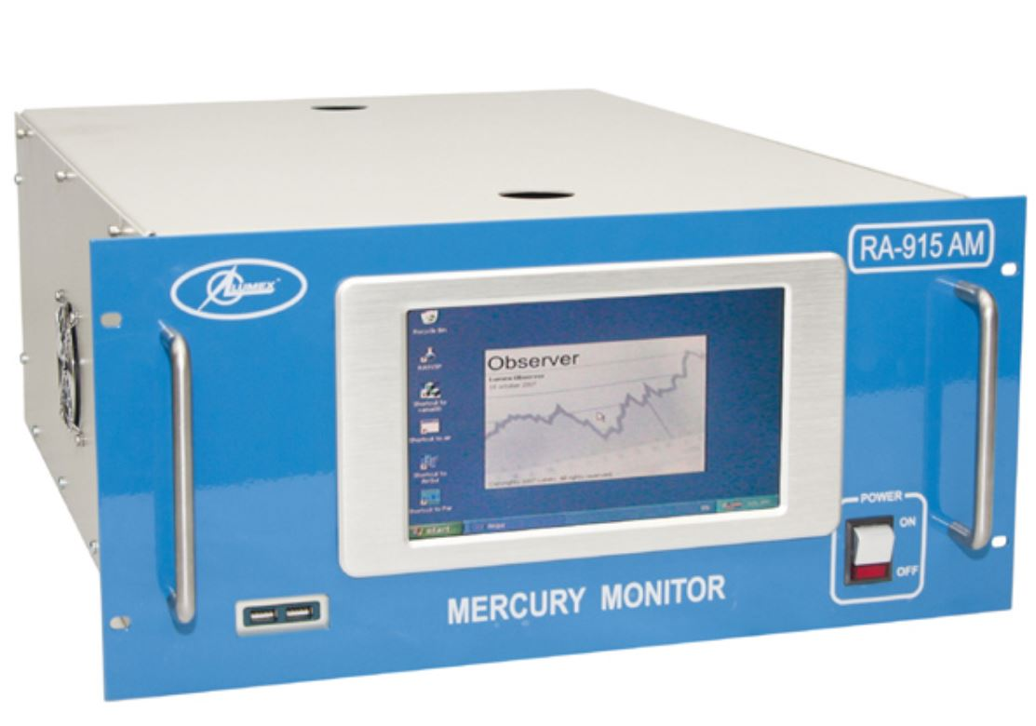
06 - Hg
Atom absorption with Zeeman background correction method, LUMEX (Canada) RA915AM
high sensitivity, especially for the real time detection of mercury vapor in air
Zeeman background correction eliminates the effect of interfering impurities
None
Hourly

Slide 13
DATA reporting
Norwegian Institute for Air Research;
WMO World Data Centre for Aerosols;
WMO World Data Centre for Greenhouse Gases;
WMO World Data Centre for Reactive Gases;
WMO World Data Centre for Precipitation Chemistry;
ICP Vegetation;
ICP Integrated Monitoring;
EEA AirBase.

Slide 14
Public disclosure

Slide 15
Public disclosure
 | PM_{2.5} | PM₁₀ | NO₂ | O₃ | SO₂
Good | 0-10 | 0-20 | 0-40 | 0-50 | 0-100
Fair | 11-20 | 21-40 | 41-90 | 51-100 | 101-200
Moderate | 21-25 | 41-50 | 91-120 | 101-130 | 201-350
Poor | 26-50 | 51-100 | 121-230 | 131-240 | 351-500
Very poor | 51-75 | 101-150 | 231-340 | 241-380 | 501-750
Extremely poor | 76-800 | 151-1200 | 341-1000 | 381-800 | 751-1250
 | General public notice | Sensitive individuals notice
Good | Air quality is very good. Enjoy usual outdoor activities | Air quality is very good. Enjoy usual outdoor activities
Fair | Enjoy usual outdoor activities | Enjoy usual outdoor activities
Moderate | Enjoy usual outdoor activities | If symptoms appear consider limiting outdoor activities
Poor | If symptoms like eye inflammation, cough or sore throat appear consider limiting intensive outdoor activities | Consider limiting physical activities, especially outdoors and if symptoms arise
Very poor | If symptoms like eye inflammation, cough or sore throat appear consider limiting intensive outdoor activities | Limit physical activities, especially outdoors and if symptoms arise
Extremely poor | Limit outdoor physical activities | Avoid outdoor physical activities

Slide 16
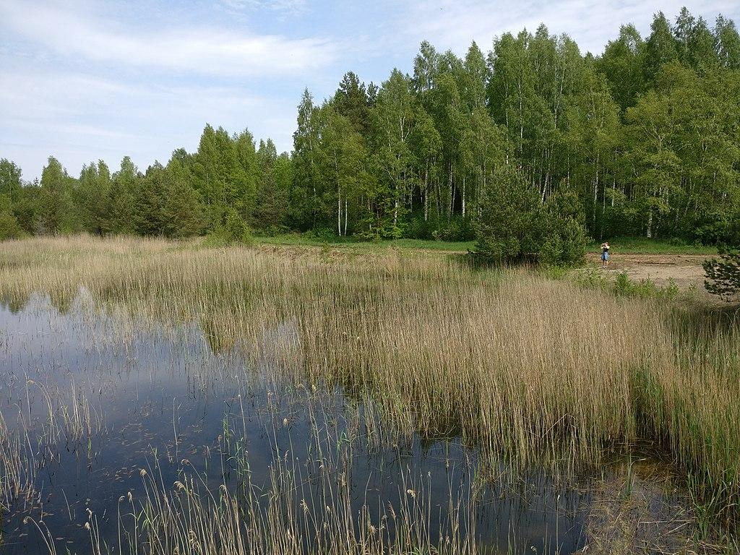
THANK YOU
Does anyone have any questions?
aleksandra.kanisceval@lvgmc.lv
videscentrs.lvgmc.lv
LVGMC_Meteo
VSIALVGMC
Nature preserve «Ķirba swamp» in Rucava parish

